Slide 1
PHYSICS LAB PROJECT
• Topic : Properties of light
• Presented By : Hitendra Sisodia
Himanshu Saraswat
Ujesh Sisodia
• Guided By : Dr. K.V Sarathlal Sir

Slide 2
PROPERTIES OF LIGHT
Total Internal Reflection
Dispersion of light
Scattering of light

Slide 3
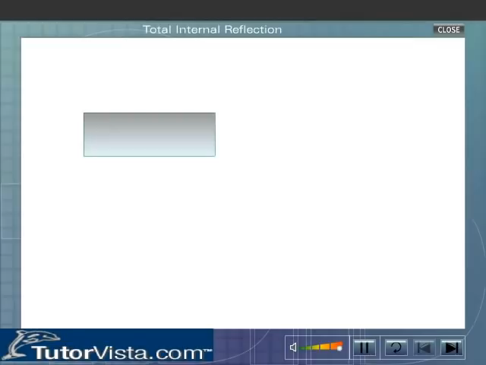
PROPERTIES OF LIGHT

Slide 4
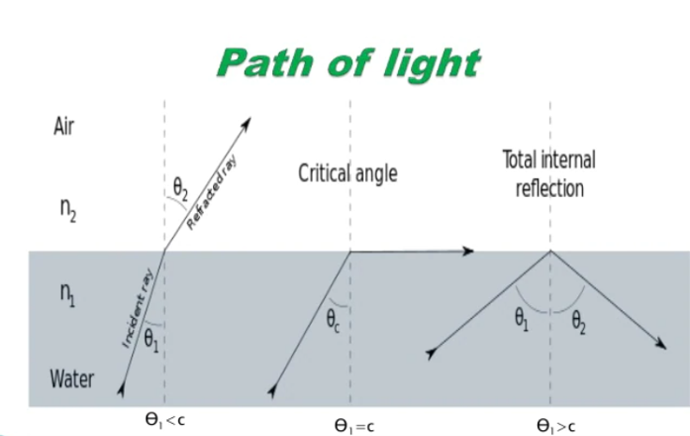
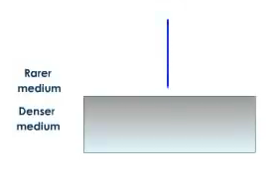
TOTAL INTERNAL REFLECTION
When light travels from a denser medium to a rarer medium, if the angle of incidence is greater than the critical angle the ray return to the denser medium. This is known as total internal reflection.

Slide 5
TOTAL INTERNAL REFLECTION
• Critical angle is the angle at which the refracted ray is at 90˚.

Slide 6
TOTAL INTERNAL REFLECTION
• Critical angle is the angle at which the refracted ray is at 90˚.
• Conditions Required For Total Internal Reflections.

Slide 7
TOTAL INTERNAL REFLECTION
• Critical angle is the angle at which the refracted ray is at 90˚.
• Conditions Required For Total Internal Reflections.
• Difference between Total Internal Reflection and Reflection
through plane mirror.

Slide 8
APPLICATION OF TOTAL INTERNAL REFLECTION
1. Optical fiber Communication

Slide 9
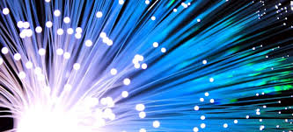
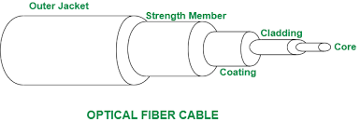
APPLICATION OF TOTAL INTERNAL REFLECTION
1. Optical fiber Communication

Slide 10
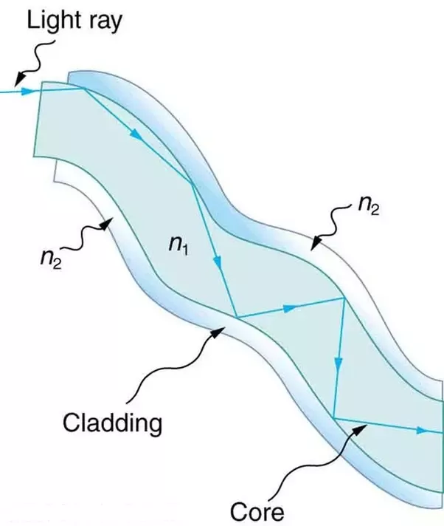
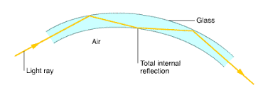
APPLICATION OF TOTAL INTERNAL REFLECTION
1. Optical fiber Communication
2. Endoscopy

Slide 11
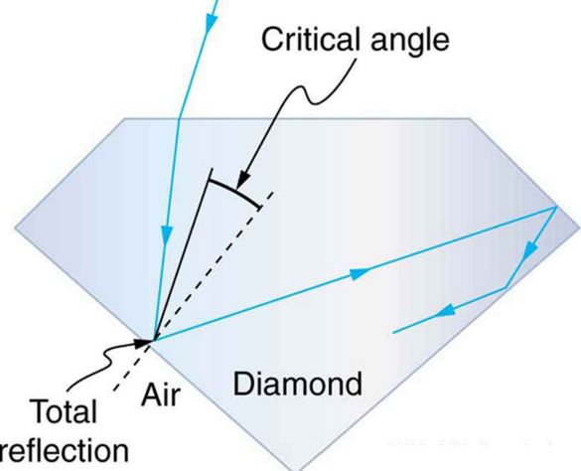
APPLICATION OF TOTAL INTERNAL REFLECTION
1. Optical fiber Communication
2. Endoscopy
3. Brilliance of diamond

Slide 12
DISPERSION OF LIGHT

Slide 13
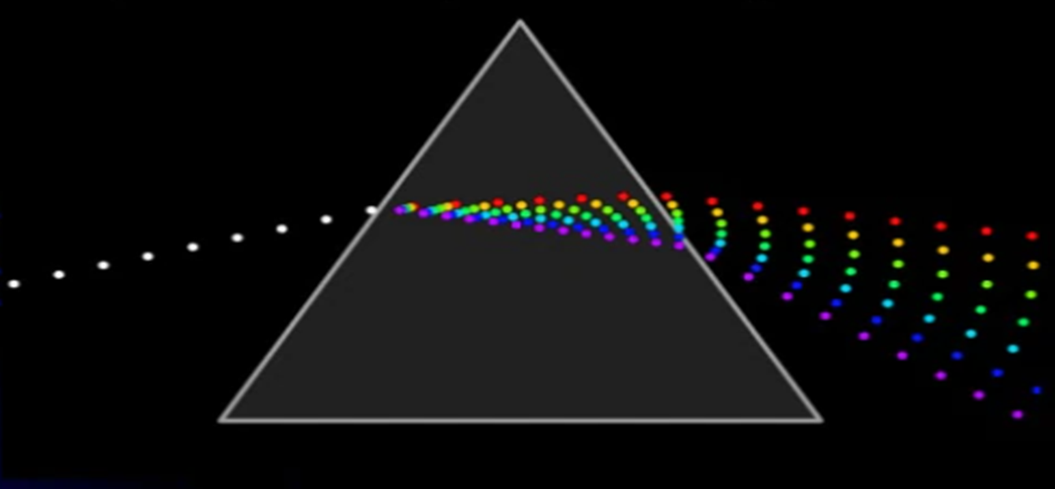
WHAT IS DISPERSION?

Slide 14
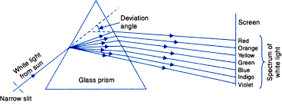
CAUSE OF DISPERSION

Slide 15
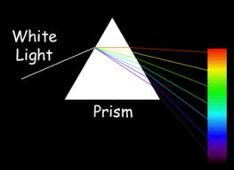
SPECTRUM

Slide 16
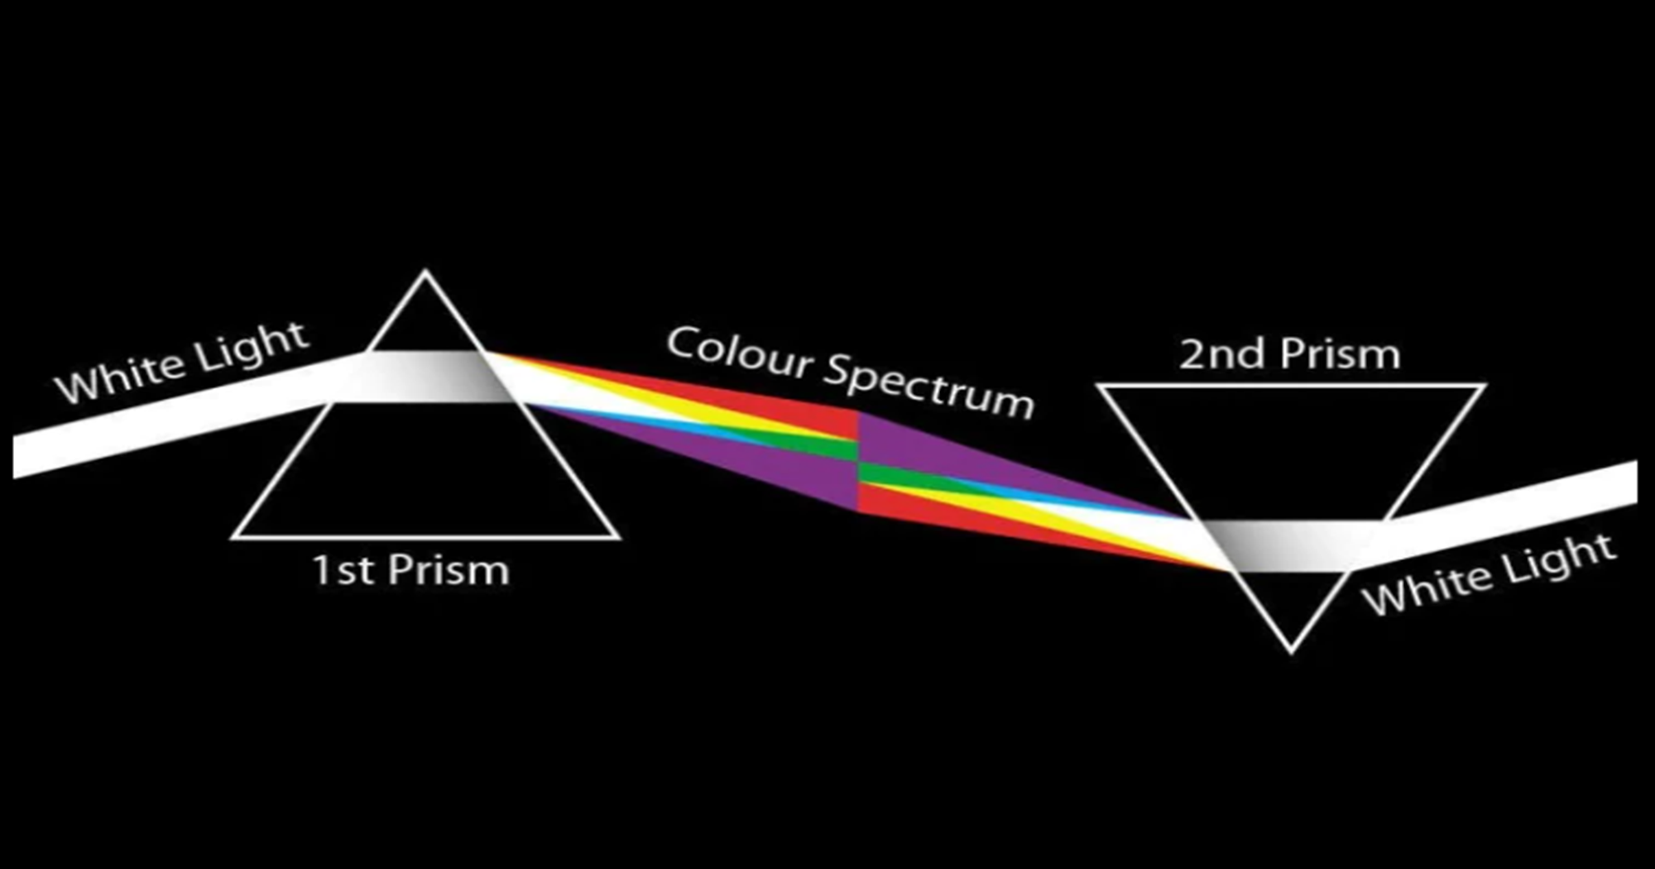
NEWTONS’S EXPERIMENT

Slide 17
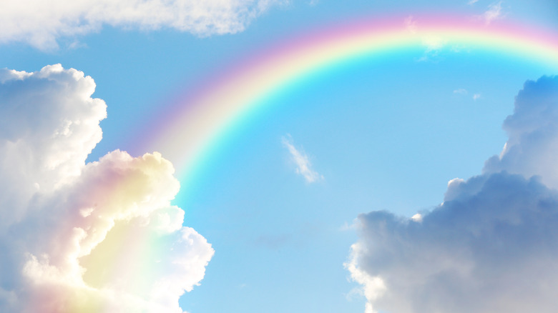
HOW RAINBOW IS FORM BY DISPERSION OF LIGHT

Slide 18
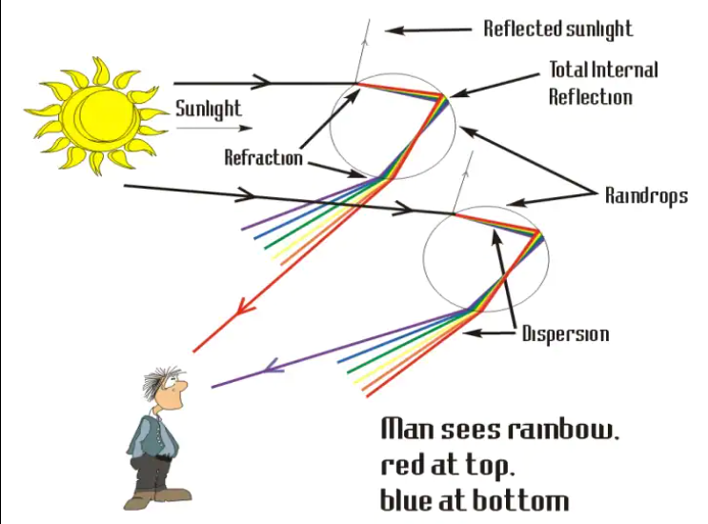
How Rainbow is seen to us?

Slide 19
LET US TALK ABOUT SOME FACTS

Slide 20
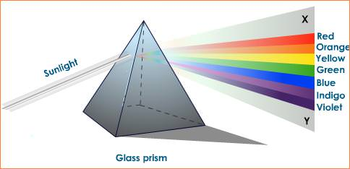
WHICH COMPONENT DEVIATES MAXIMUM AND MINIMUM?

Slide 21
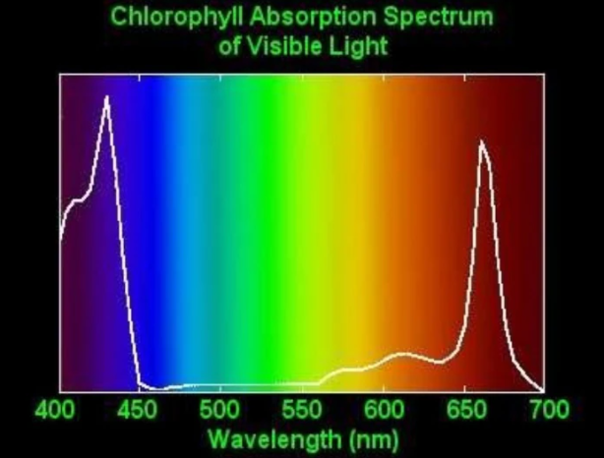
WHAT IS THE RATE OF PHOTOSYNTHESIS?

Slide 22
WHAT IS THE NATURE OF SPECTRUM EMERGING OUT OF THE SECOND PRISM?

Slide 23
SCATTERING OF LIGHT

Slide 24
What is Scattering?
Scattering is a general physical process whereby some forms of radiation such as light or moving particles,
are forced to deviate from straight trajectory by one or more localized non-uniformities in the medium through which it passes.

Slide 25
TYPES OF SCATTERING OF LIGHT
1. Selective or Rayleigh Scattering
2. Mie Scattering

Slide 26
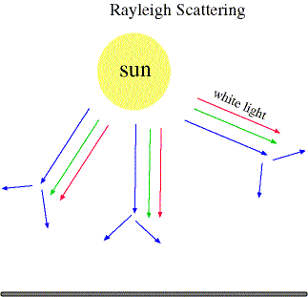
1.Selective or Rayleigh Scattering

Slide 27
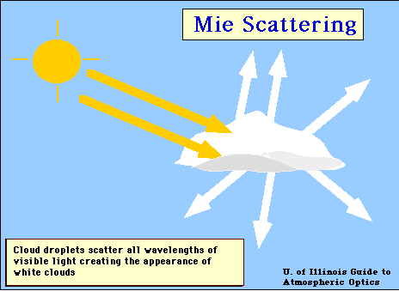
2. Mie Scattering

Slide 28
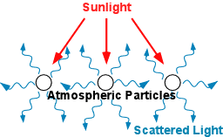
SCATTERED LIGHT

Slide 29
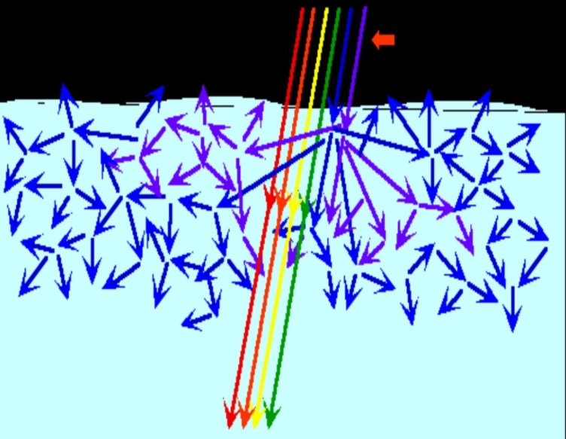
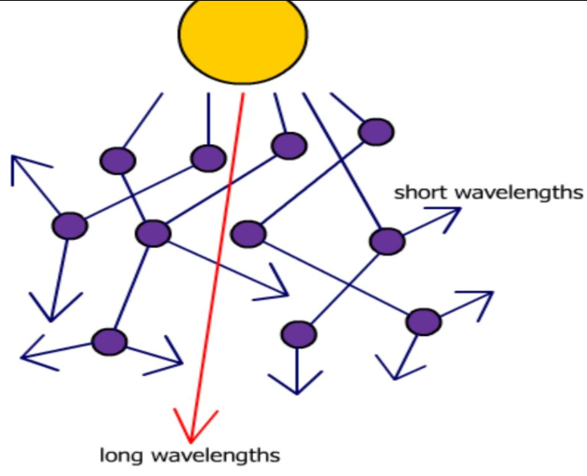
SCATTERED LIGHT IN SUBSTANCE AND AIR

Slide 30
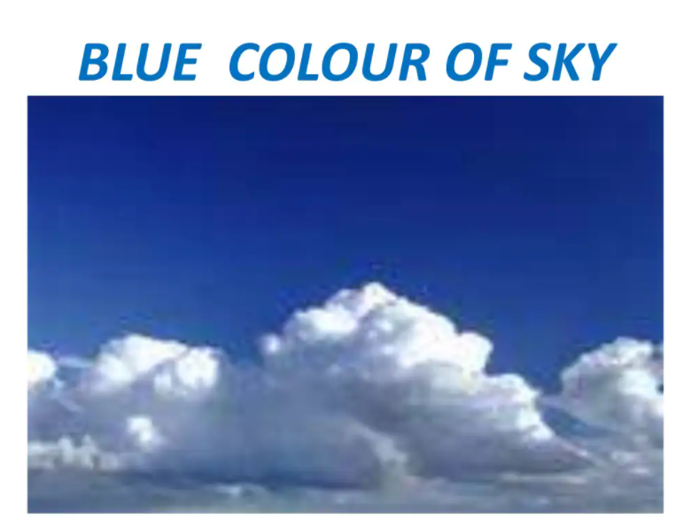
BLUE COLOUR OF SKY

Slide 31
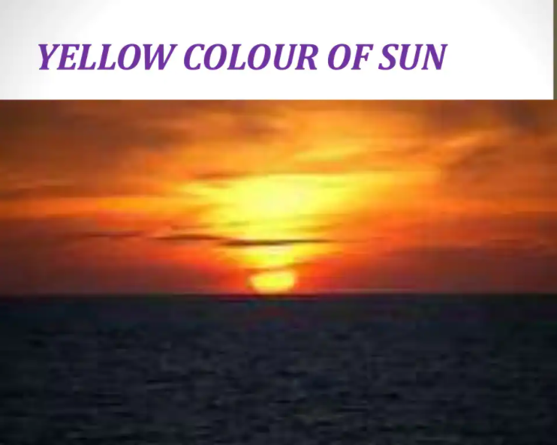
YELLOW COLOUR OF SUN

Slide 32
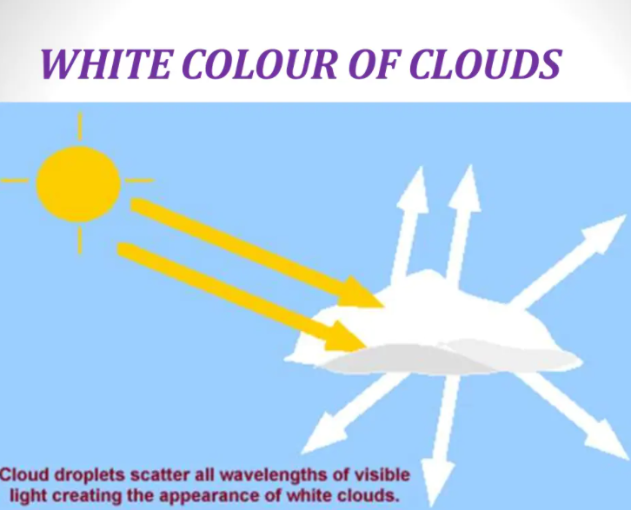
WHITE COLOUR OF CLOUDS

